Slide 1


Training Tuesdays

Slide 2

Thank you for participating in the inaugural session of Training Tuesdays. We are excited to present these training opportunities and hope you will find them to be beneficial.

Slide 3
Plan Name

Slide 4
Plan Name: The Basics
ERISA requires employee welfare benefit plans (group health plans) to have their own identifying information, including plan name, plan number & plan year.
Information must be included on plan’s form 5500 (if applicable) so the DOL can recognize the plan.
Must be included in SPD so participants can identify their plan.
There are no specific legal requirements in determining a plan name, however, they typically include the Plan Sponsor’s name and a general description of the benefits provided (e.g. The Jackson Laboratory Health Plan).

Slide 5
Plan Name vs. Plan Administrator/Sponsor Name
The Plan Name is different than the Plan Administrator/ Sponsor’s name.
Plan Administrator/Sponsor name is typically the Client or Group’s legal business name.
Plan Administrator/Sponsor establishes the plan, determines the benefits, amends the plan and terminates the plan.
The Plan Sponsor/Plan Administrator name is not the actual group health plan Plan Name and the does not contain Employee Health Plan, Medical Plan, etc.

Slide 6
Plan Name –vs- Plan Administrator/Sponsor Name Examples
Plan Name
The Cheesecake Factory Incorporated Health & Welfare Plan – Core 3000D Plan
Sandata Technologies, LLC Employee Benefit Plan
Allstate Power Vac Employee Benefit Plan
Plan Administrator/Sponsor Name
The Cheesecake Factory Incorporated
Sandata Technologies, LLC
ACV Enviro Corporation

Slide 7
Plan Name: Further Information
Occasionally, clients will not include their legal business name within their Plan Name. Examples of this include, but are not limited to removing Inc. or LLC from Plan Name or using acronyms:

Slide 8

For Sebago Technics, “Inc.” should not be included as part of Plan Name. Remove Inc. (also remove comma) from Name of Plan in document template.
SUMMARY OF MATERIAL MODIFICATION
AND
AMENDMENT #1
TO THE
SEBAGO TECHNICS, INC.
PLAN
GROUP NO. ____
This Summary of Material Modification and Amendment describes changes to the Sebago Technics, Inc. Plan effective

Slide 9
The same rule applies to Rosehill Gardens, Inc. Inc. is not part of the Plan Name so it should NOT appear in documents where Plan Name is shown:

Slide 10
For Oregon Mennonite Residential Services, the legal business name (Oregon Mennonite Residential Services, Inc.) and Plan Name (OMRS POS Plan) are different.
In this case, the Client does not use their legal business name + the name of the Plan. Instead they chose an acronym of their name & the plan type as their Plan Name.

Slide 11

Plan Name Source of Truth

Slide 12
Where to Find Plan Name for Documents
New Groups
Plan Name is requested/supplied on the Client Information Form during implementation (available on Implementation SharePoint site)
Can be confirmed during Benefit Question Calls
Renewals
Latest General Plan Information Section of the Plan Document

Slide 13
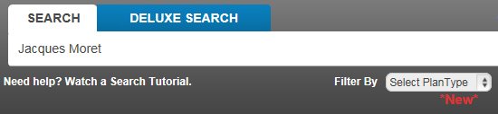
Additional Resources
For ERISA Plans, the Free ERISA website can also be used as a tool to verify the Plan Name.
Go to https://freeerisa.benefitspro.com/?login =true to register – registration is free.
Search by the client’s name to find a list of all form 5500 filings.

Slide 14
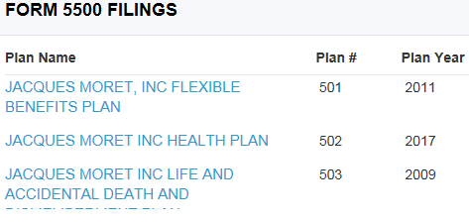
Scroll down list until you find applicable Plan.
Update Plan Name and Plan # in your amendment or restate if necessary.

Slide 15

When in doubt, don’t assume
Ask for assistance from QA, Supervisor
Refer to Free ERISA website
Request the Account Owner/Implementation Manager obtain confirmation from the Client

Slide 16
Applying Plan Name in Documents

Slide 17
Plan Name - Contracts
Verify Plan Name(s) via Plan Document using General Plan Information section
Do not assume Plan Name always is “Employee Benefit Plan”
Include all applicable Plan Names in introductory paragraph of the ASA
This Administrative Services Agreement (this “Agreement”), effective as of {---Effective Date---} (the “Effective Date”), is by and between Meritain Health, Inc., (including any of its affiliates performing Services hereunder) having its principal office at 300 Corporate Parkway, Amherst, New York 14226 (“Meritain”) and {---Client Name---} having its principal office at {---Street1---}, {---Street2---}, {---City---}, {---State/Province---} {---Postal Code---} (“Client”). This Agreement applies to services to be provided by Meritain to Client in connection with Client’s self-funded employee welfare benefit plan(s) formally known as: {---Legal Plan Name---} (the “Plan”). In consideration of the mutual covenants and promises stated herein, and other good and valuable consideration, the receipt and sufficiency of which are acknowledged by each party, the parties agree as follows:

Slide 18

Plan Name: Amendment/SBC Instructions
To verify Plan Name, DO NOT look at prior amendments. Go to 1st line of most recent General Plan Information section.
In amendment template, everywhere you see “Group Name Name of Plan”, match name exactly as it appears in General Plan Information.
Include this same name in the header section of the SBC.

Slide 20

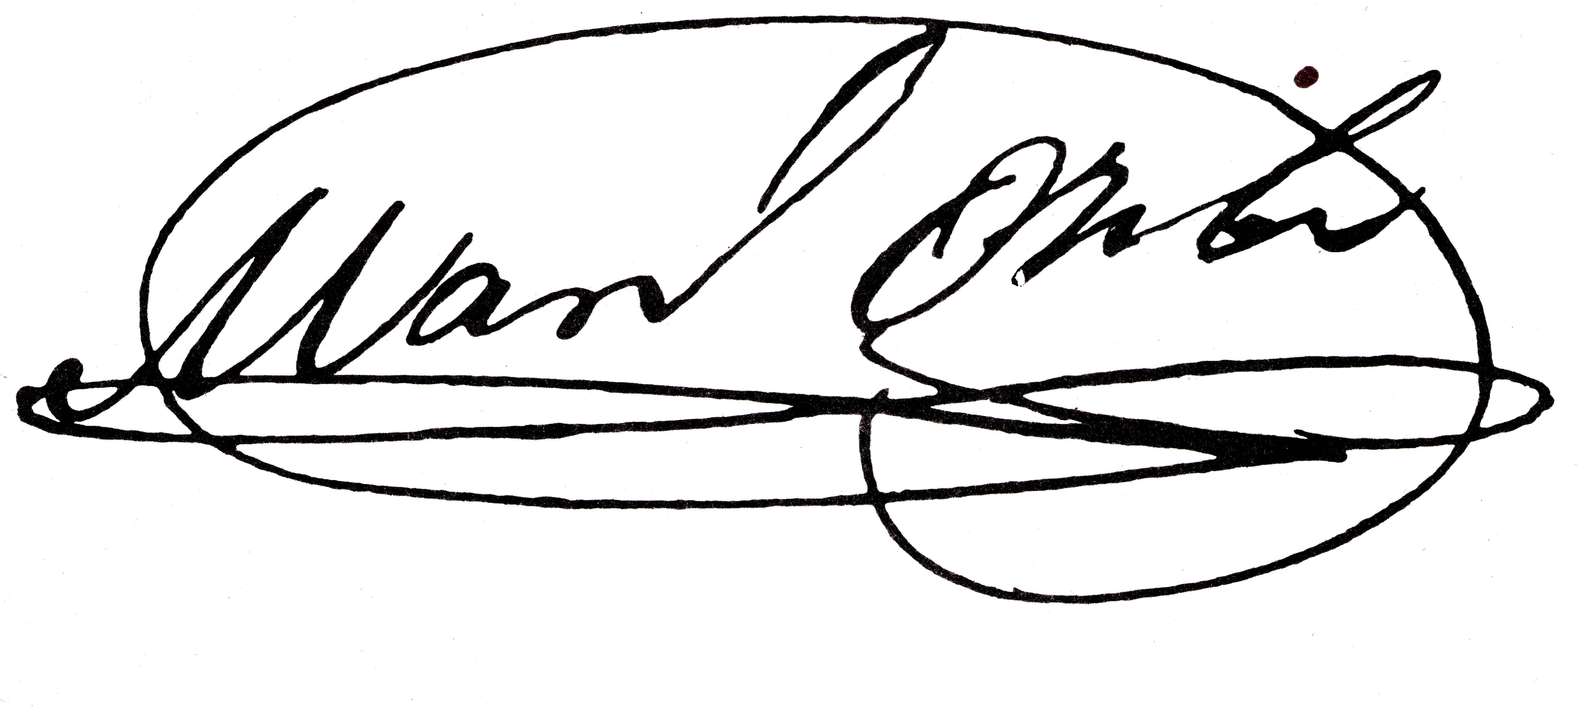
Before the signature lines, “Name of Plan” is just the Plan Name without the Group’s Name, e.g. Health Plan or Employee Benefit Plan.

Slide 21
Plan Name: Multiple Documents
Some clients have multiple Plan Documents. Examples of this include, but are not limited to separate docs for each plan option or separate docs for union and non-union Employees.

Slide 22

For clients with multiple Plan Documents, they should be named differently to distinguish each doc. If you come across a client with multiple docs which are all named the same, add the Name of the Plan option to the footer, saved name AND the amendment heading (even if it is not listed in General Plan Information).

Slide 23

Piedmont Eye Center (16240) has 4 Plan Documents:
500/25 Plan
1000/30 Plan
2000/30 Plan
5000 HSA Plan
Amendment #4 for the 500 Plan should be saved as 16240-04-500Plan.
Plan option name should also be included in header:
SUMMARY OF MATERIAL MODIFICATION
AND
AMENDMENT #4
TO THE
PEC EMPLOYEE BENEFIT PLAN
500 PLAN
GROUP NO. 16240

Slide 24




Plan Name: Reminders
Use General Plan Information to verify the Plan Name.
Don’t copy the Plan Name from prior amendments.
Use Free ERISA website when the Plan Name is unknown or in question for ERISA Plans.

Slide 25


Thanks!
Any questions?
Please send questions related to specific scenarios to Beth Westman via email.

